Slide 1
DDD Pacemaker
Utsav Trivedi and Feneel Sanghavi

Slide 2
Design
Our idea was to make FSMs to monitor/control Heart Events.
This reduces logic significantly from making FSMs for each heart timer.
Our desired outcome was met which was to achieve all functionality with the least amount of complexity possible.
paceMaker.C contains the logic to handle events from pacemakerFSM.c (which is the compiled ScCharts program), as well as controlling functionality based on mode.

Slide 3
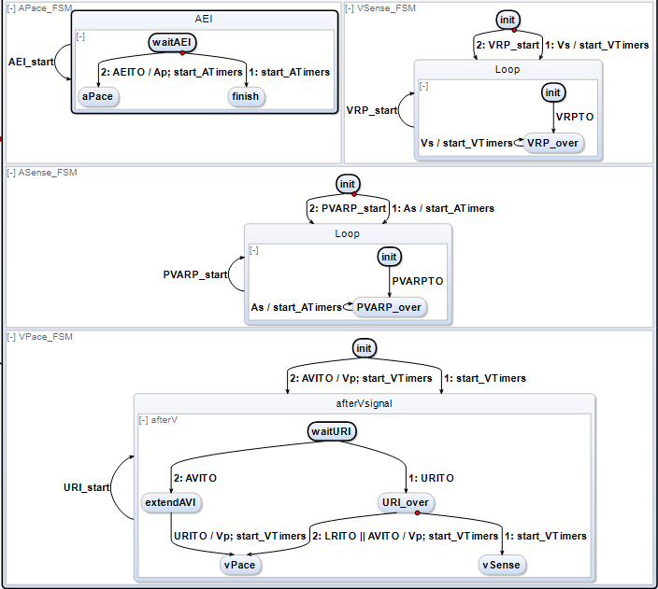
Control Unit

Slide 4
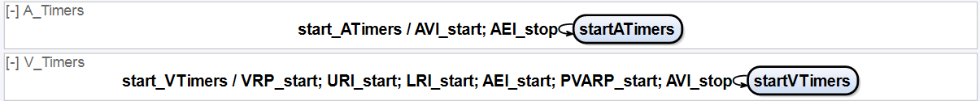
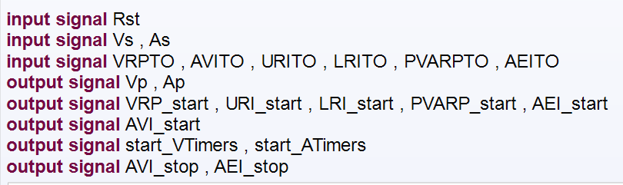
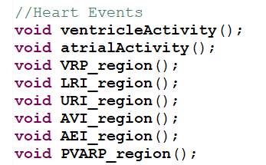
Timers and interface(handling events)
The input and output signals to control timer peripherals.
There are functions in pacemaker.C program to handle all heart events with each tick().

Slide 5
C code implementation
All appropriate timers were initialised with their interrupts enabled for them.
Pacemaker FSM tick() is called in the while loop.
Green led 0 and 1 are used to show VPace and APace signals
Mode 1 : Buttons 0 and 1 are used to provide VSense and ASense signals.. All regions are handled after the tick function.
Mode 2: Non-blocking UART is used to interface the virtual heart program with the pacemaker.It paces the heart according to diseases selected.

Slide 6
Thanks for listening!

